Slide 1

ELECTRICITY DEMAND
AND
PRICE FORECASTING
~PRESENTED BY SOUMITA BHATTACHARJEE
INTERN AT INFOSYS SPRINGBOARD
soumitabhattacharjee02@gmail.com

Slide 2
PROBLEM STATEMENT
Total Load Prediction:
Develop a machine learning model to forecast the total energy load.
Incorporate features such as historical load data, weather conditions, time variables, and socio-economic indicators.
Energy Price Prediction:
Create a model to predict energy prices using historical price data, load forecasts, market trends, and external factors such as weather and economic activities.
Integration and Analysis:
Integrate the total load and price prediction models to provide comprehensive insights for utility companies and consumers.
Analyze the impact of different factors on load and price fluctuations, and identify key drivers of demand and price changes.
Expected Outcomes:
Utility Companies:
Enhanced ability to plan and allocate resources efficiently.
Improved grid stability through accurate load forecasting.
Economic benefits from better price predictions and load management.
Consumers:
Ability to make informed decisions about energy usage based on price forecasts.
Potential for cost savings by adjusting consumption during lower price periods.
Market Impact:
Overall improvement in energy market efficiency.
Reduction in energy wastage and better alignment of supply and demand.

Slide 3
INDEX
TOPIC.
1. DATA INTRODUCTION
2. MISSING VALUE PERCENTAGE
3. BASIC PREPROCESSING OF DATA
4. EXPLORATORY DATA ANALYSIS
5. FEATURE ENGINEERING AND VISUALIZATION
6. FEATURE SELECTION, DATA SPLIT, MODELS USED
7. DIFFERENT ML MODELS
8. COMPARISON OF MODELS
9. IMPORTANT VARIABLES
10. FINAL MODEL SELECTION AND PLOT
CONCLUSION

Slide 4
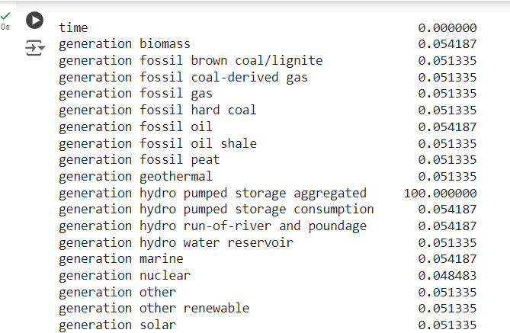
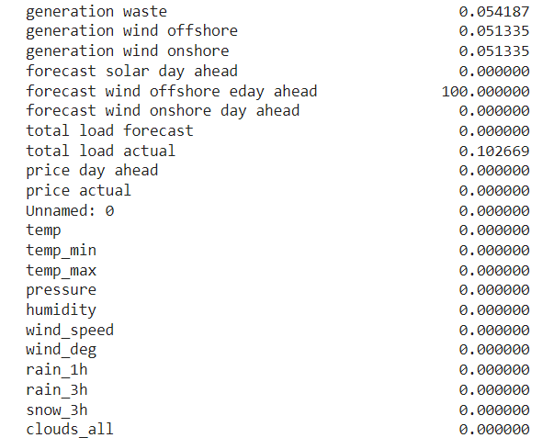
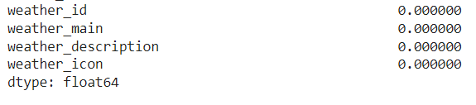
DATA INTRODUCTION
We were given two datasets-
Weather Features- 178396 rows and 17 columns
Energy dataset- 35064 rows and 29 rows
The Weather Features dataset was grouped together by cities and then merged with the Energy dataset
The merged dataset had 35064 rows and 44 columns
Granularity of data: Data was present in an hourly format spanning from years 2015 to 2018
MISSING VALUE PERCENTAGE
After dropping 2 columns with 100 % missing value percentage and columns with all 0’s- dimension of dataset is 35064 rows and 36 columns.

Slide 5
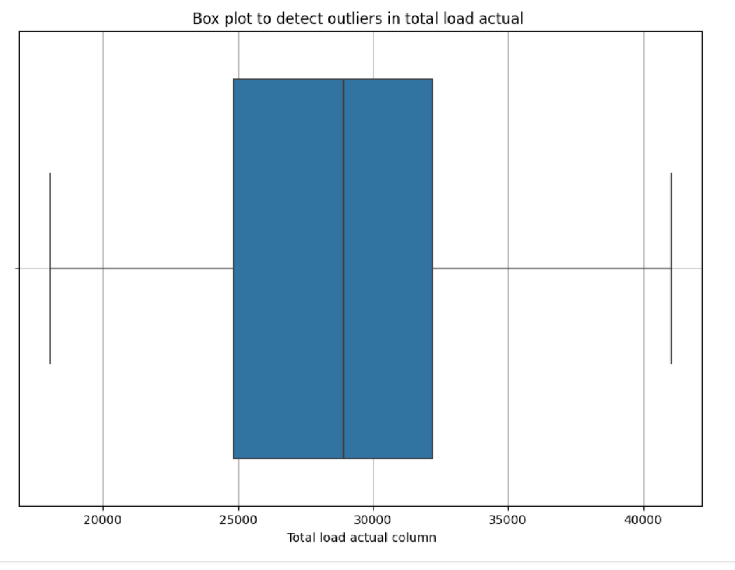
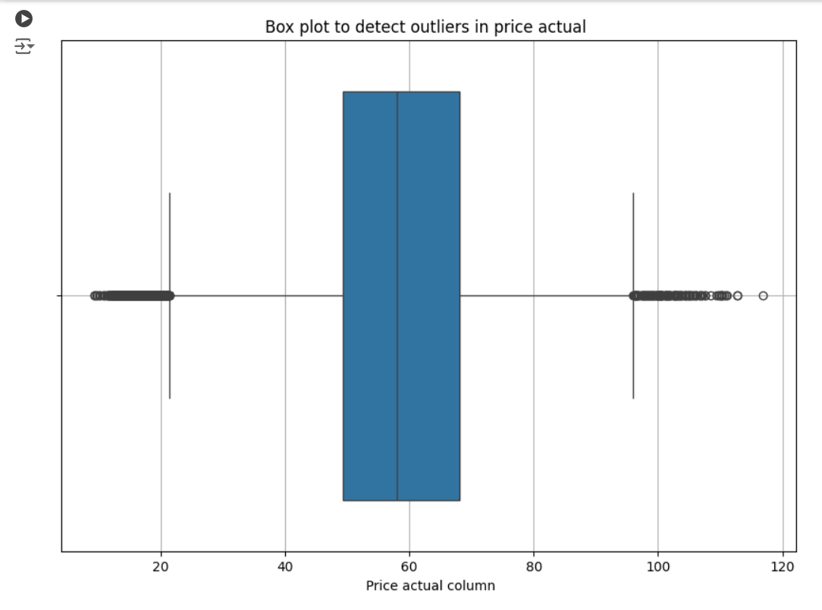
BASIC PREPROCESSING OF DATA
Steps taken to preprocess the data:
Dropping columns with all null values, all 0 values and any unnamed coloumns
Fetching data information and statistics using info and describe function.
Outlier detection and visualization for ‘total load actual’ and ‘price actual’
Outlier visualization
Imputing missing values with forward fill and backward fill

Slide 6
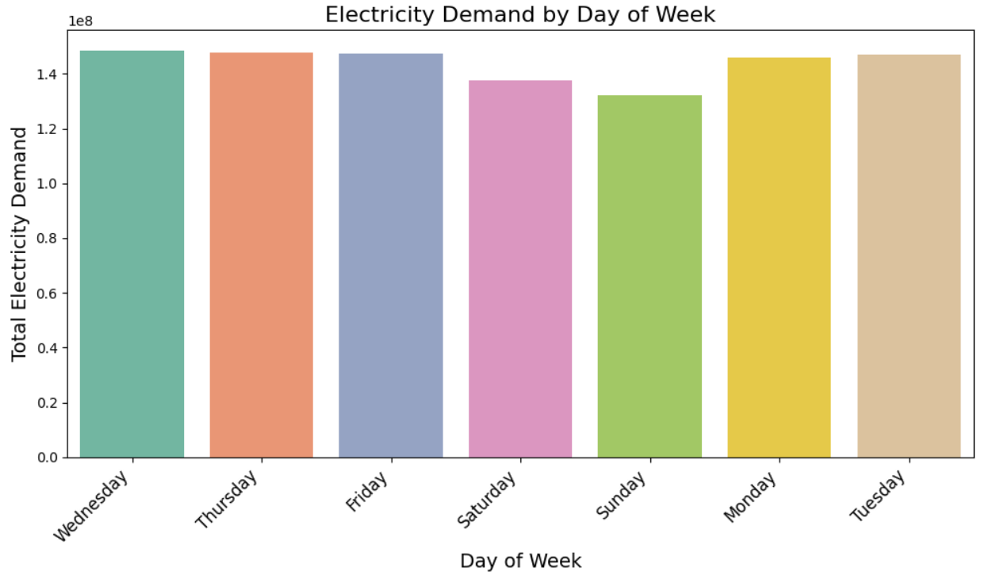
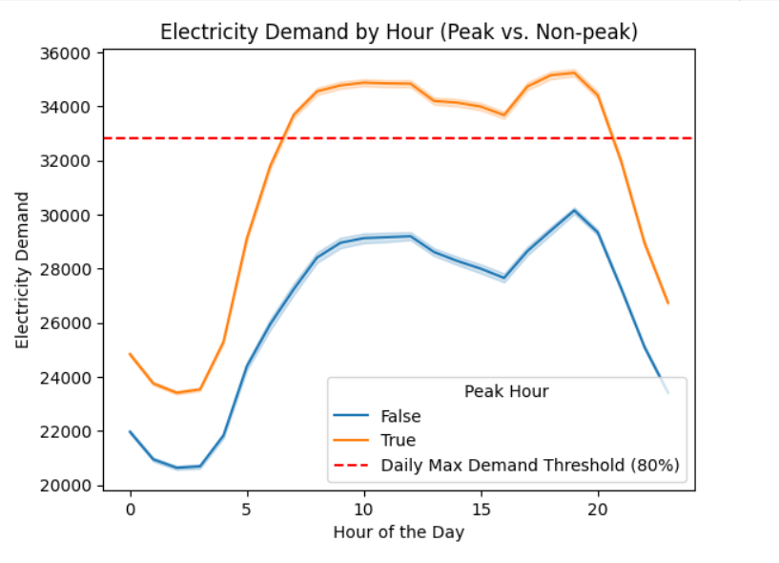
EXPLORATORY DATA ANALYSIS
We have determined correlation matrix for weather and energy dataset variables-
Some important weather variables are temperature, humidity, wind speed, wind degree
Some important energy variables are generation fossil brown coal, generation fossil gas, generation fossil hard coal, hydro pumped storage consumption and price day ahead.
FEATURE ENGINEERING AND VISUALIZATION

Slide 7
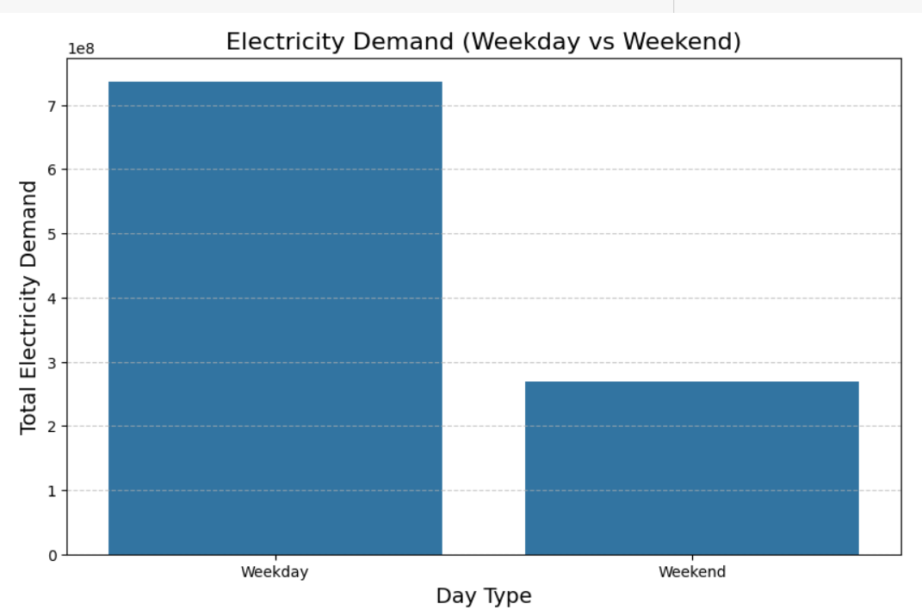
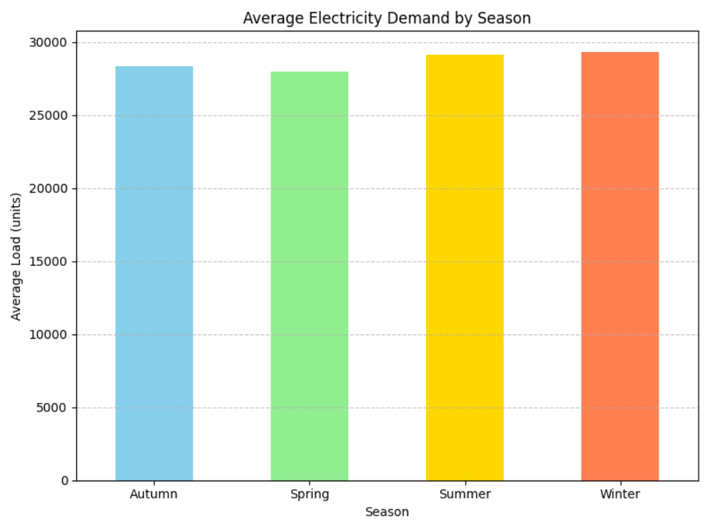
Insights from data:
Monday, Tuesday and Wednesday sees highest demand. In general weekdays see more demand than weekends.
Summers and Winters both see almost equally high demand.

Slide 8
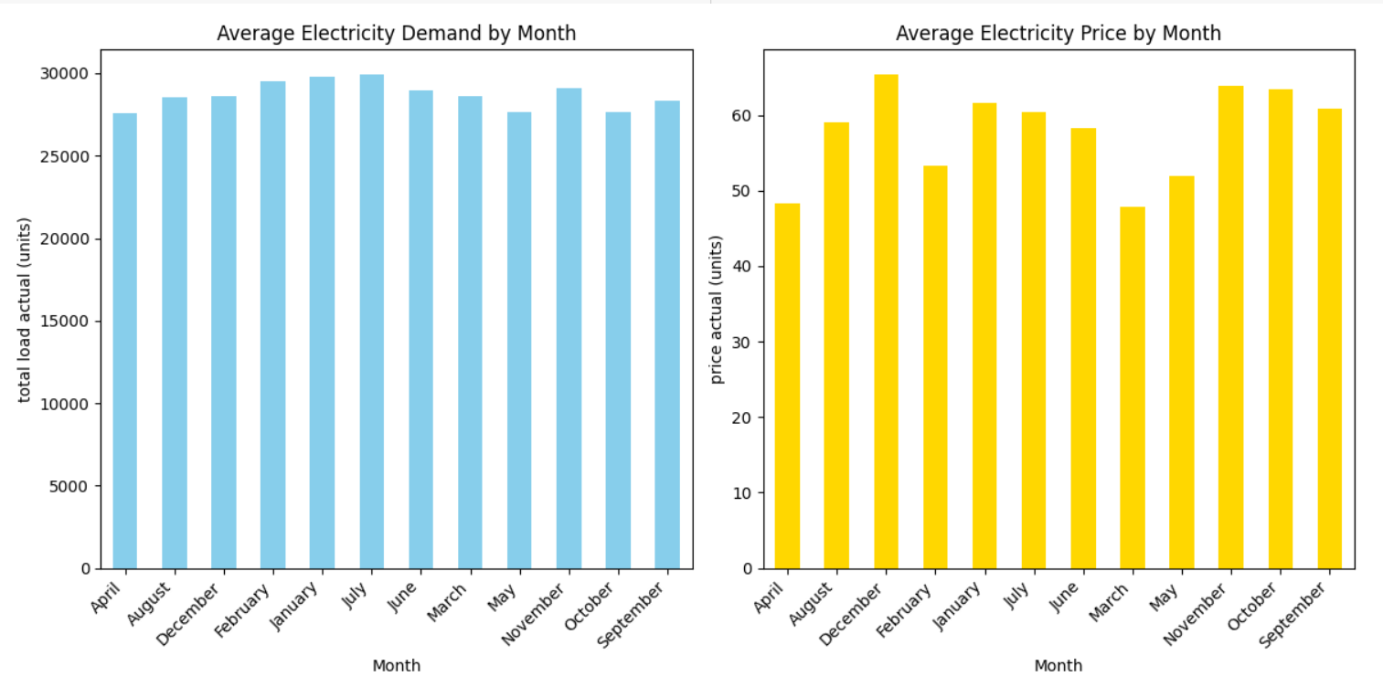
Maximum average electricity demand seen in January and July.
Maximum average electricity price is seen in December.

Slide 9
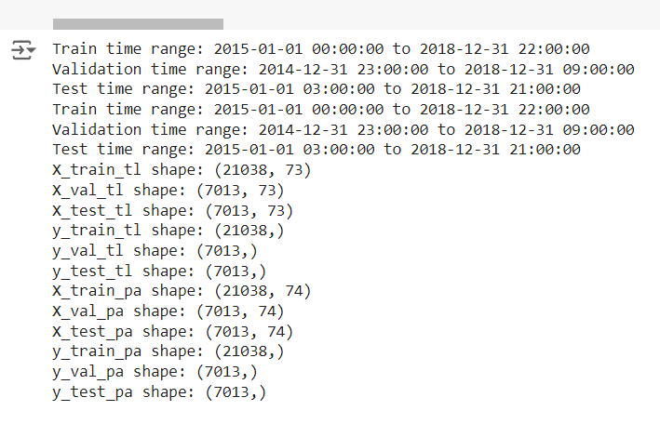
FEATURE SELECTION AND DATA SPLIT AND TRAINING
Selecting feature sets for target variables 'total load actual’ and 'price actual’. We only select features with correlation coefficient greater than and equal to 0.05
We divide the dataset into training , validation and test data with a ratio of 60:20:20 . For each of the target variables we train the data for different feature set. NOTE:tl suffix is for total load and pa is for price actual.
MODELS USED FOR PREDICTION
Linear regression
Random forest
Gradient boosting
Random forest with hyperparameter tuning
Gradient boosting with hyperparameter tuning
Long short term memory(lstm)

Slide 10
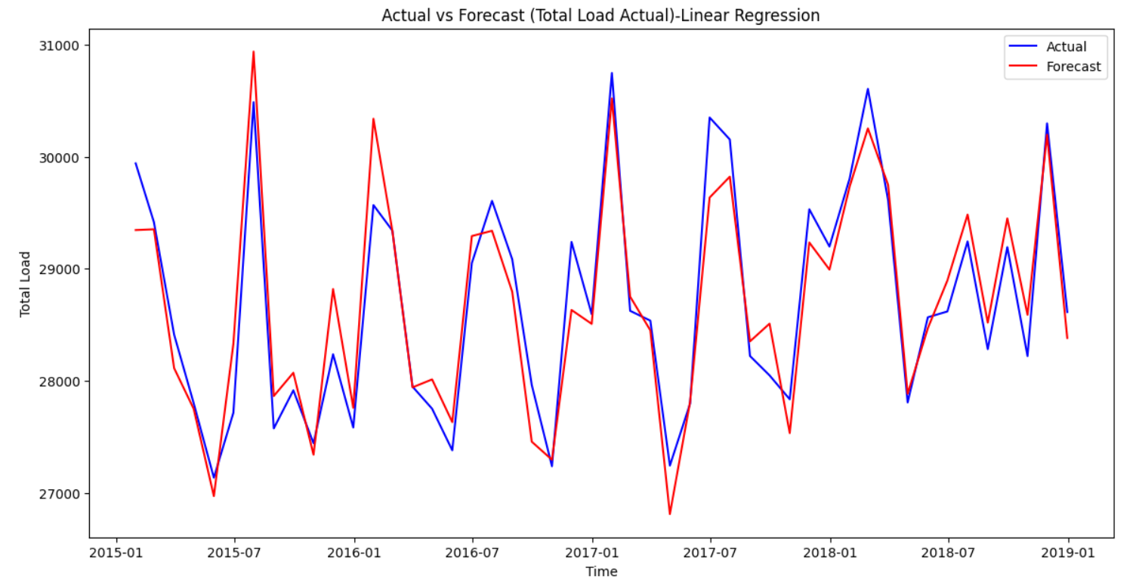
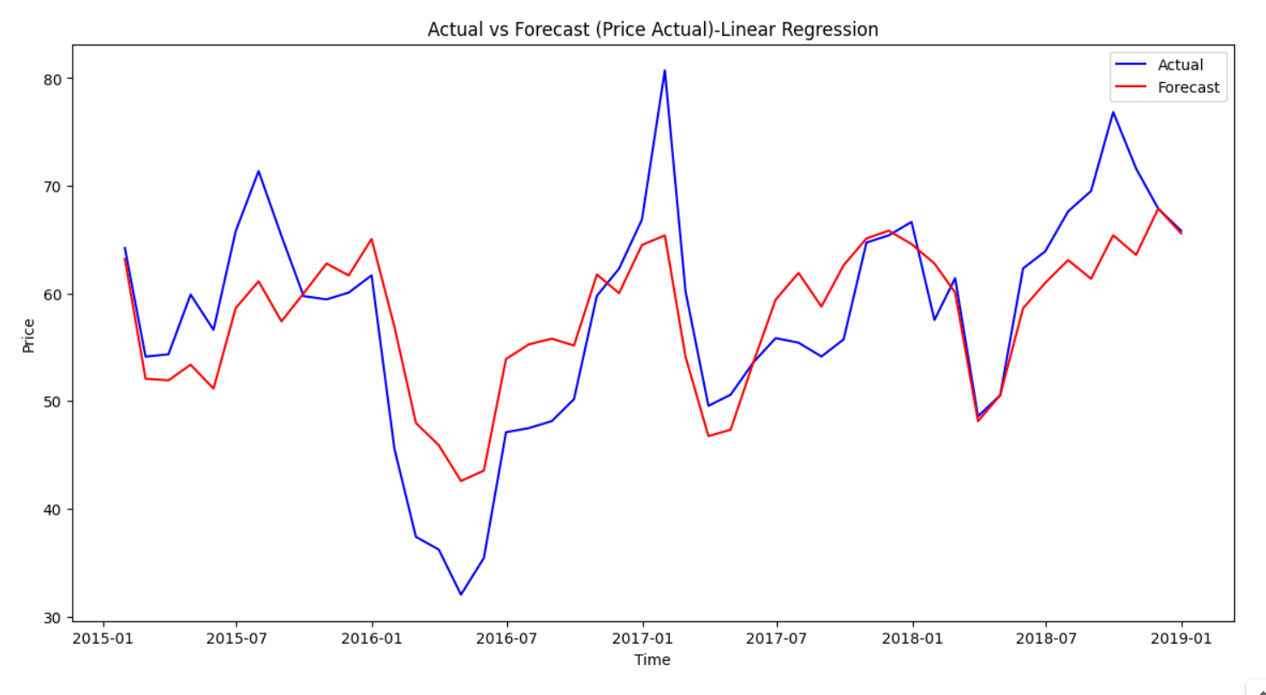
LINEAR REGRESSION
ERROR METRICS AND ACTUAL VS FORECAST PLOT FOR TOTAL LOAD ACTUAL(LEFT) AND PRICE ACTUAL(RIGHT)
Metrics for Total Load Actual:
MAPE: 4.39%
R2: 0.88
Adjusted R2: 0.88
MAE: 1218.81
RMSE: 1550.38
Metrics for Price Actual:
MAPE: 14.96%
R2: 0.57
Adjusted R2: 0.56
MAE: 7.32
RMSE: 9.38

Slide 11
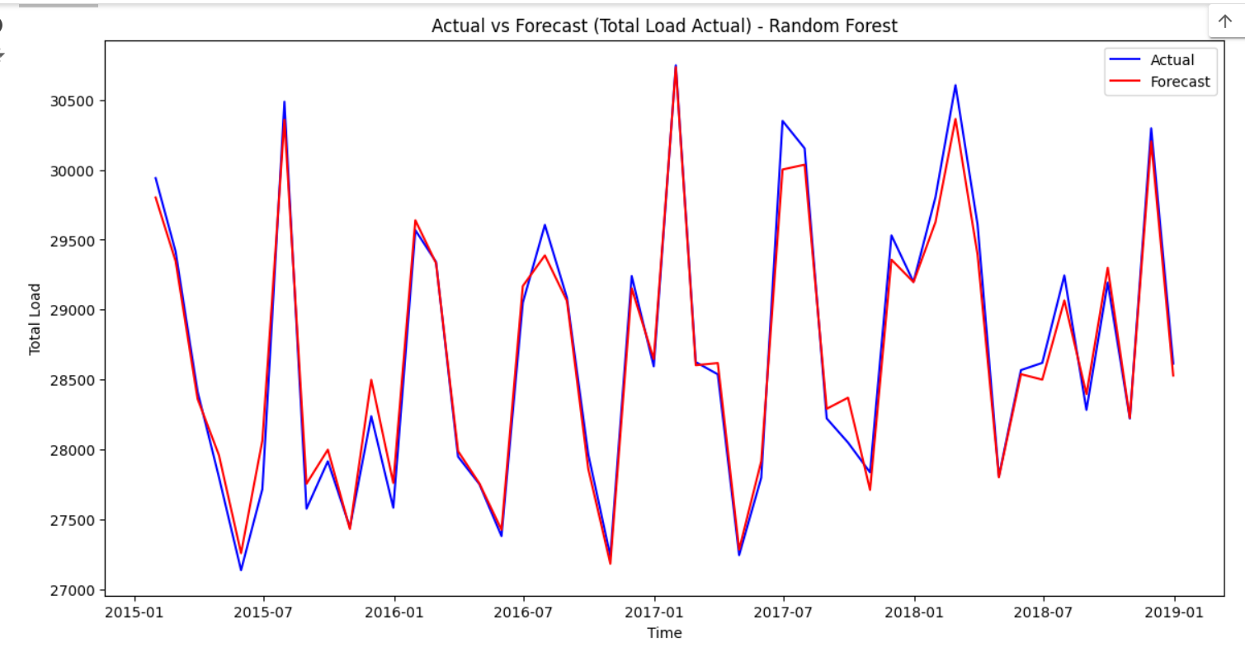
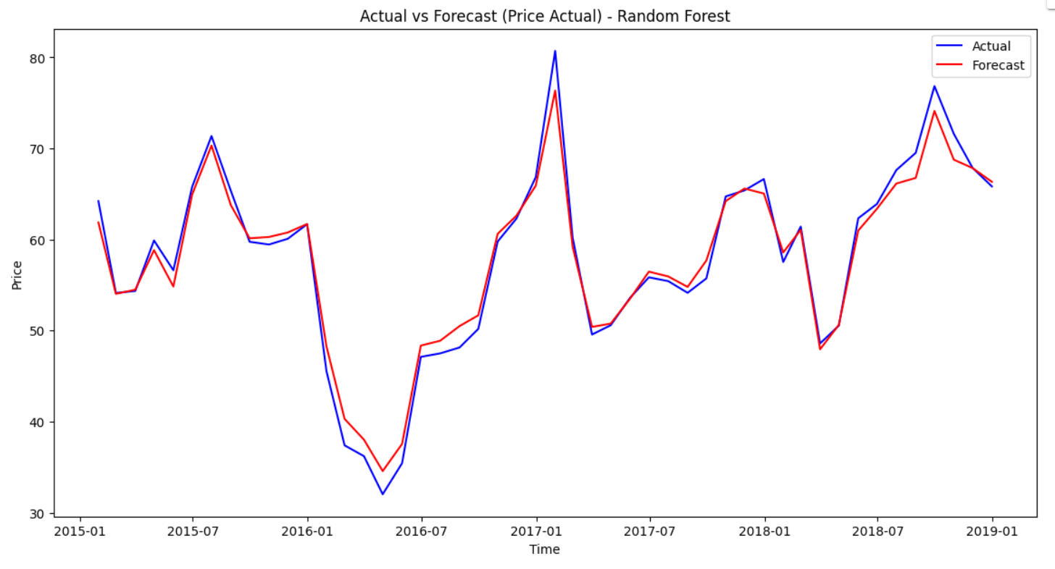
RANDOM FOREST
ERROR METRICS AND ACTUAL VS FORECAST PLOT FOR TOTAL LOAD ACTUAL(LEFT) AND PRICE ACTUAL(RIGHT)
Metrics for Total Load Actual using Random Forest:
MAPE: 2.65%
R2: 0.95
Adjusted R2: 0.95 MAE: 737.02
RMSE: 983.00
Metrics for Price Actual using
Random Forest:
MAPE: 6.44%
R2: 0.90
Adjusted R2: 0.90
MAE: 3.14
RMSE: 4.56

Slide 12
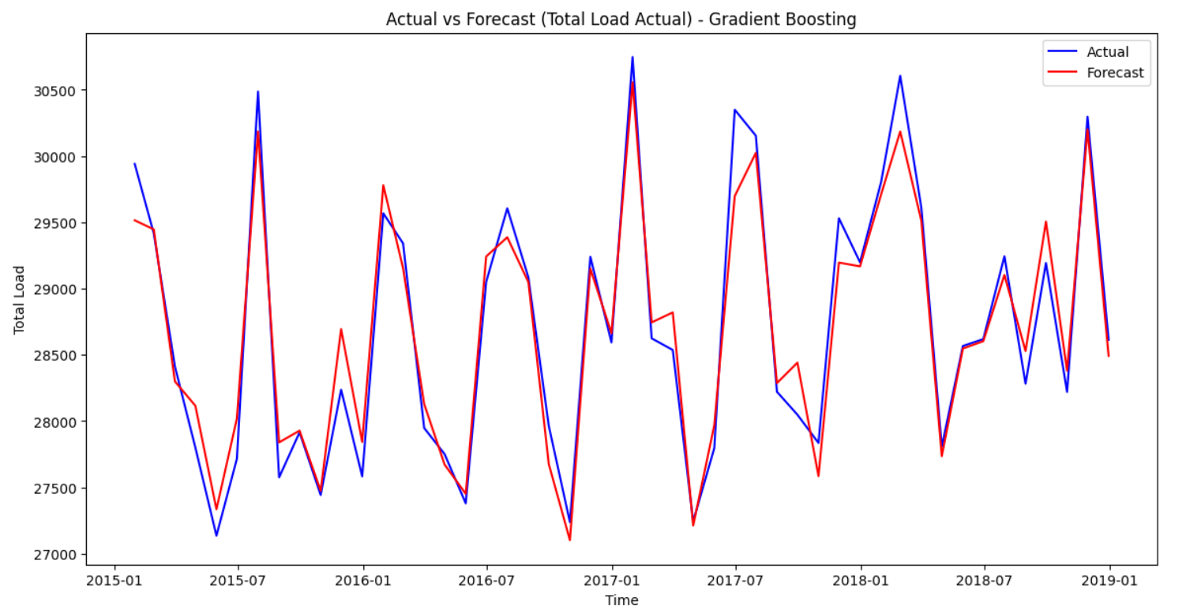
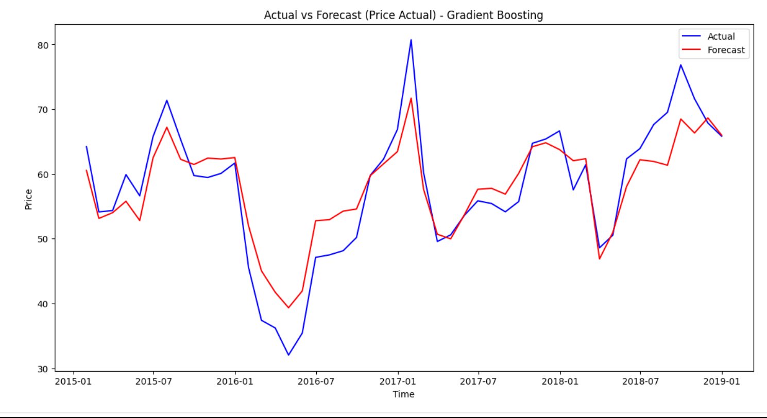
GRADIENT BOOSTING
ERROR METRICS AND ACTUAL VS FORECAST PLOT FOR TOTAL LOAD ACTUAL(LEFT) AND PRICE ACTUAL(RIGHT)
Metrics for Total Load Actual using Gradient Boosting:
MAPE: 3.63%
R2: 0.92
Adjusted R2: 0.92
MAE: 1023.55
RMSE: 1303.02
Metrics for Price Actual using Gradient Boosting:
MAPE: 11.52%
R2: 0.73
Adjusted R2: 0.73
MAE: 5.63
RMSE: 7.36

Slide 13
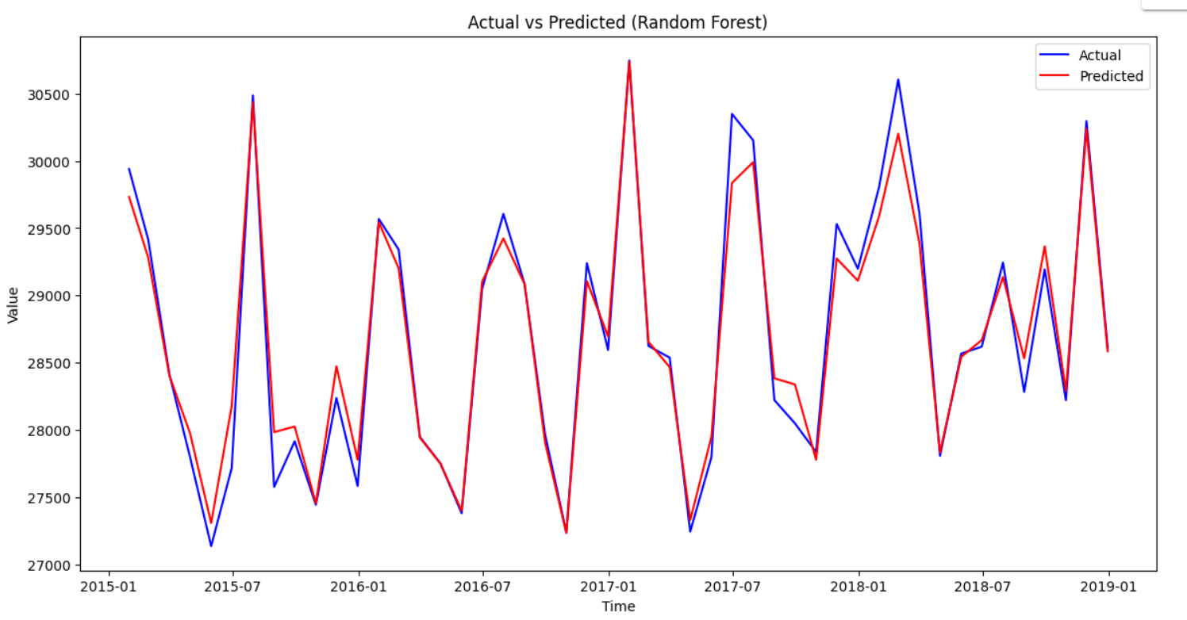
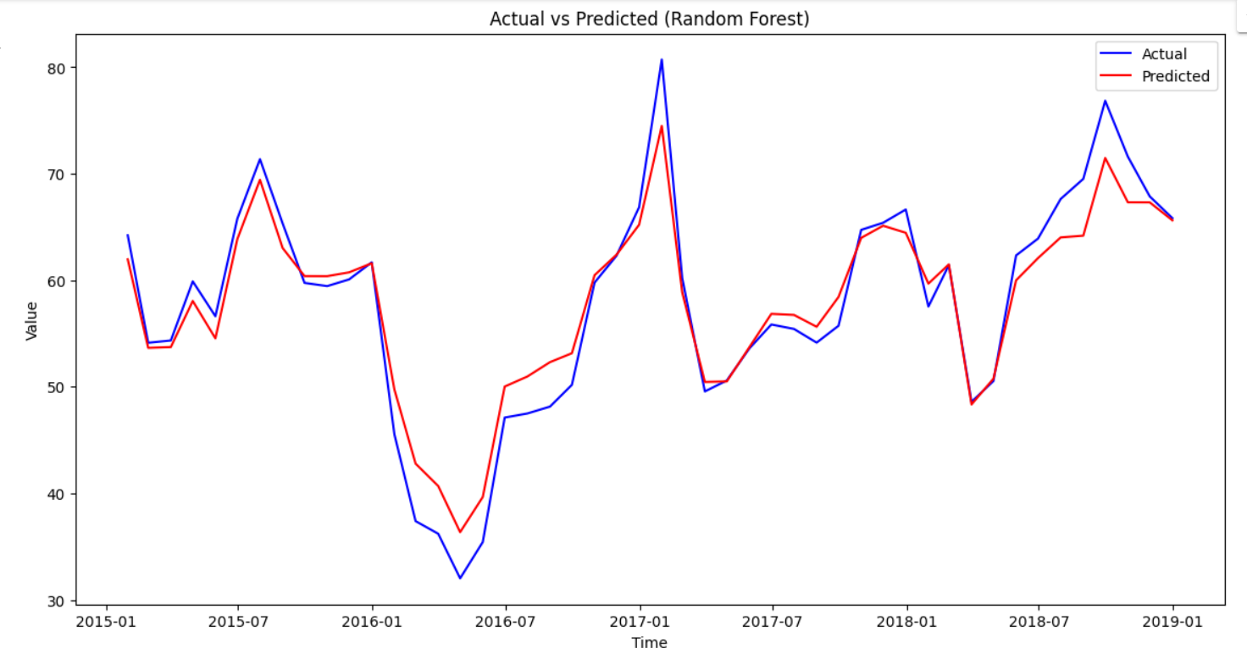
ERROR METRICS AND ACTUAL VS FORECAST PLOT FOR TOTAL LOAD ACTUAL(LEFT) AND PRICE ACTUAL(RIGHT)
RANDOM FOREST WITH HYPERPARAMETER TUNING
Test MAPE: 2.87%
Test R-squared (R2): 0.9474
Test Adjusted R-squared: 0.9468
Test MAE: 804.4730
Test RMSE: 1047.5360
Test MAPE: 7.72%
Test R-squared (R2): 0.8743
Test Adjusted R-squared: 0.8729
Test MAE: 3.6964
Test RMSE: 5.0532

Slide 14
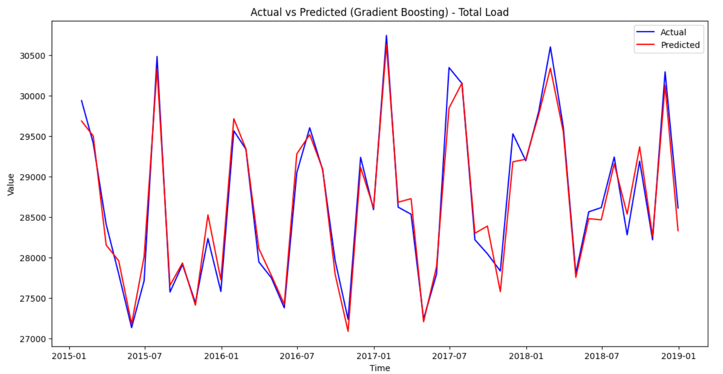
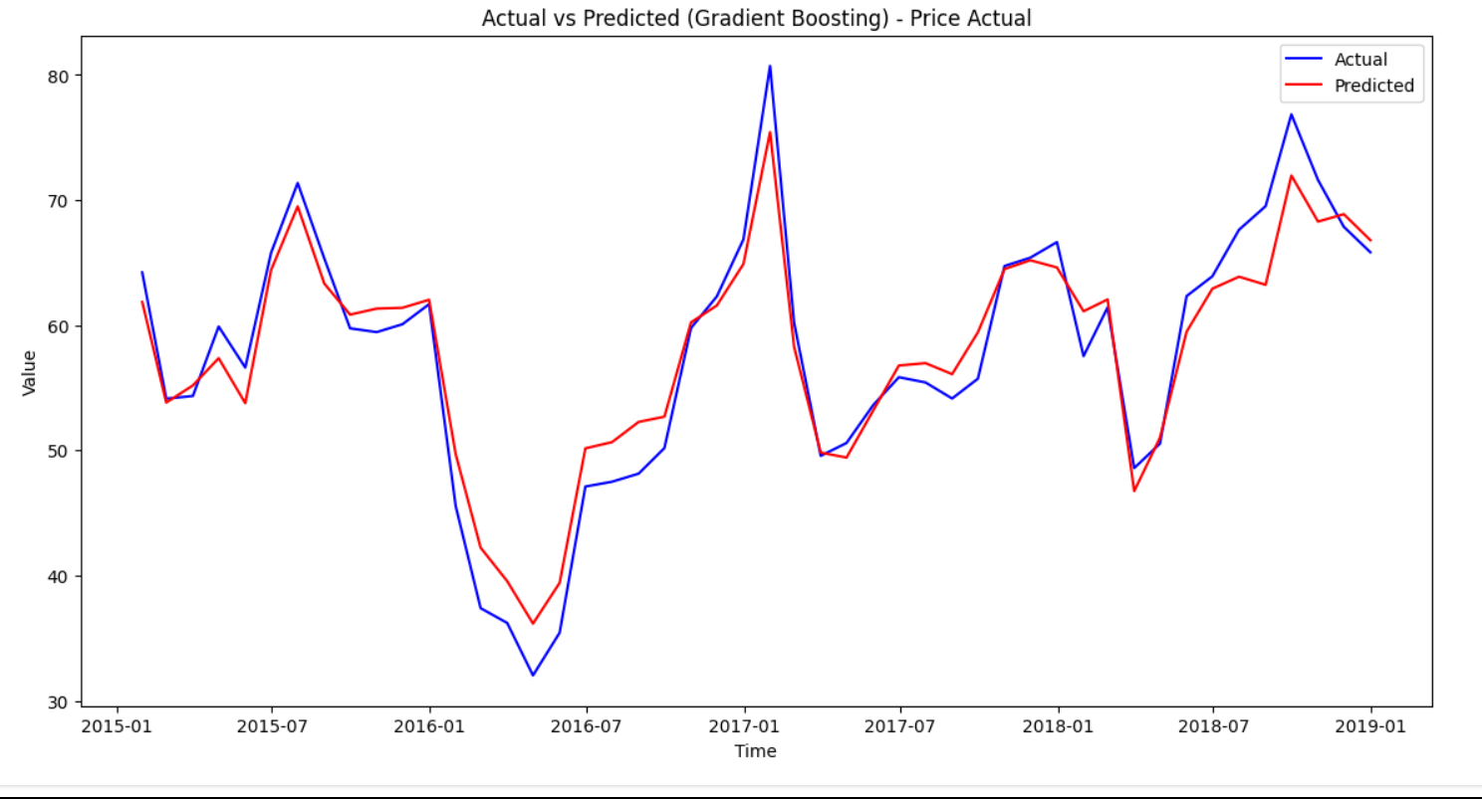
GRADIENT BOOSTING WITH HYPERPARAMETER TUNING
ERROR METRICS AND ACTUAL VS FORECAST PLOT FOR TOTAL LOAD ACTUAL(LEFT) AND PRICE ACTUAL(RIGHT)
Test set metrics for 'total load actual' using Gradient Boosting:
MAPE: 3.12%
R-squared (R2): 0.9380
Adjusted R-squared: 0.9374
MAE: 879.7937
RMSE: 1136.8729
Test set metrics for 'price actual' using Gradient Boosting:
MAPE: 9.30%
R-squared (R2): 0.8191
Adjusted R-squared: 0.8172
MAE: 4.5936
RMSE: 6.0611

Slide 15
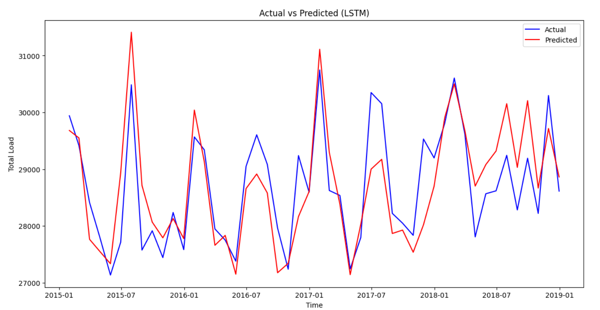
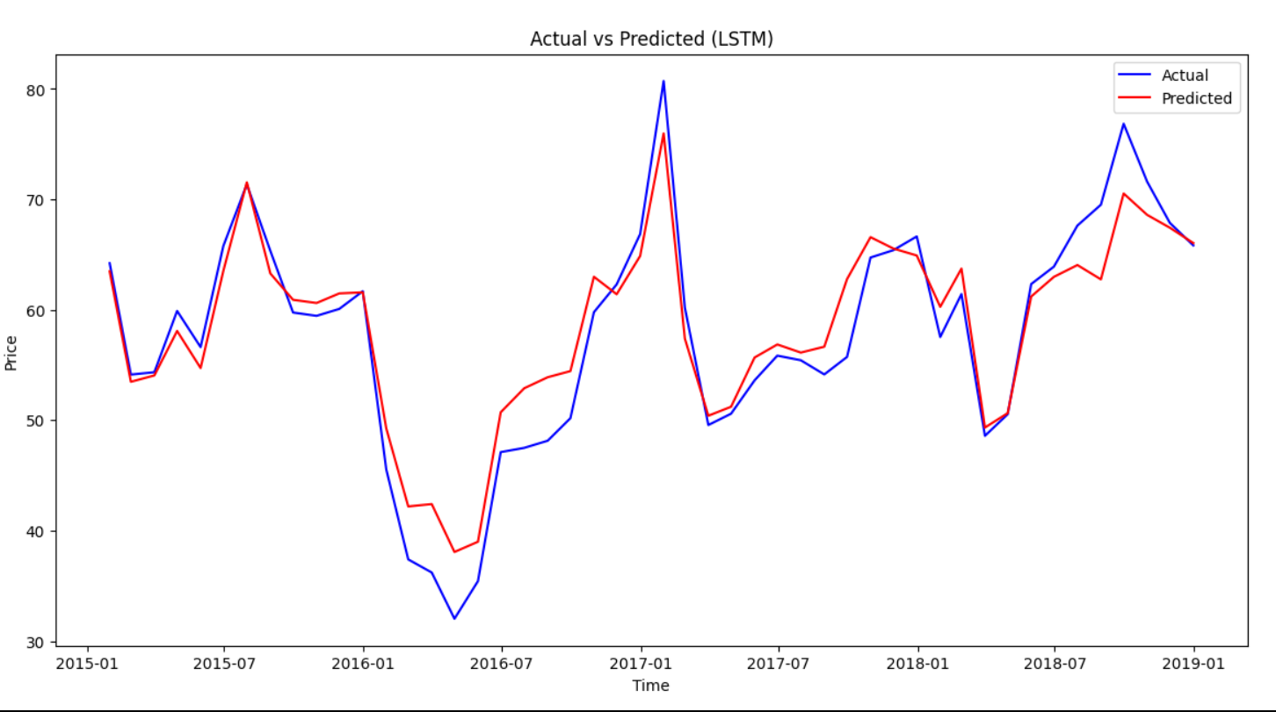
LSTM
ERROR METRICS AND ACTUAL VS FORECAST PLOT FOR TOTAL LOAD ACTUAL(LEFT) AND PRICE ACTUAL(RIGHT)
Load Metrics:
Test MAPE: 5.31%
Test R-squared (R2): 0.83
Test Adjusted R-squared: 0.83
Test MAE: 1479.97
Test RMSE: 1863.58
Metrics:
Test MAPE: 10.42%
Test R-squared (R2): 0.78
Test Adjusted R-squared: 0.78
Test MAE: 5.11
Test RMSE: 6.69

Slide 16
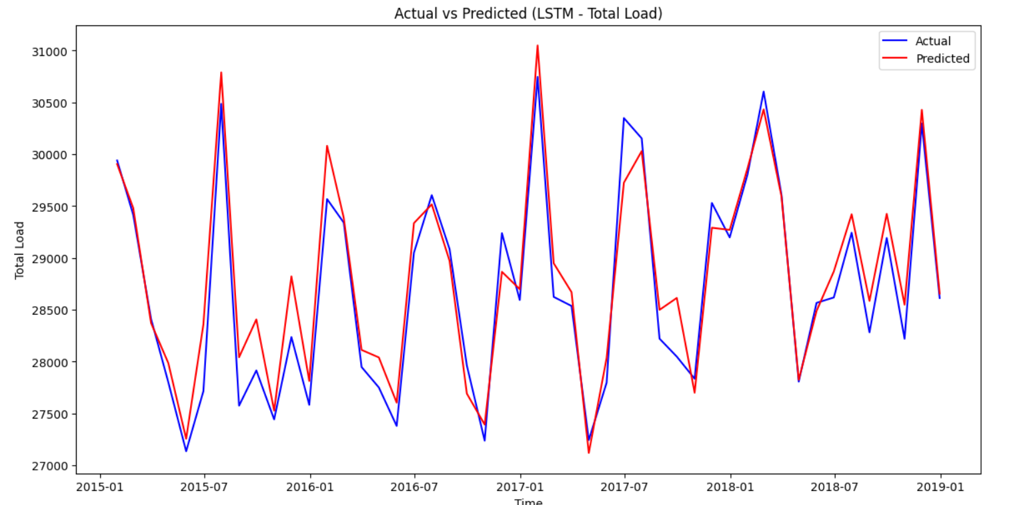
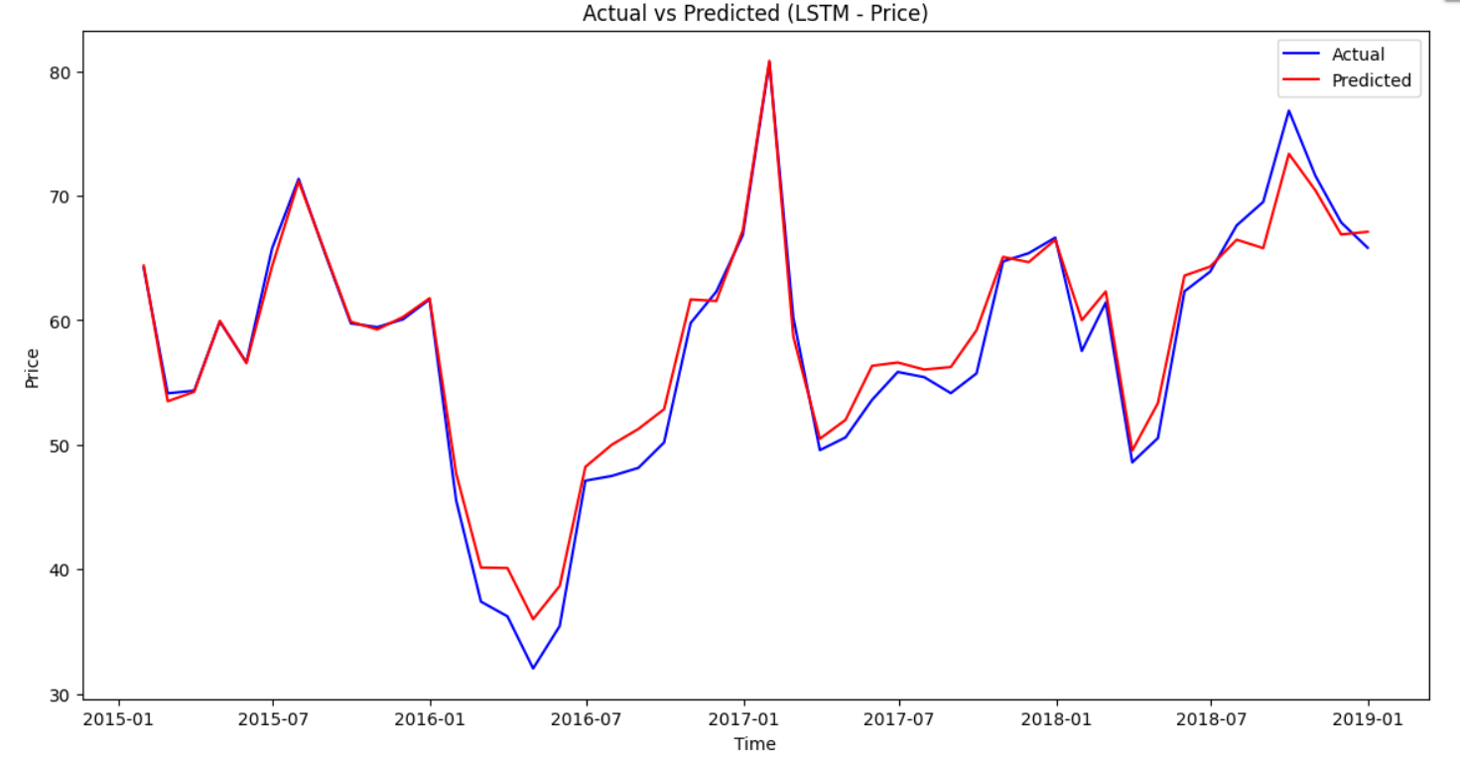
LSTM-HYPERPARAMETER TUNED
ERROR METRICS AND ACTUAL VS FORECAST PLOT FOR TOTAL LOAD ACTUAL(LEFT) AND PRICE ACTUAL(RIGHT)
Best metrics for 'total load actual’:
MAPE: 3.81%
R-squared (R2): 0.91
Adjusted R-squared: 0.91
MAE: 1059.24
RMSE: 1372.29
Best metrics for 'price actual’:
MAPE: 8.60%
R-squared (R2): 0.85
Adjusted R-squared: 0.84
MAE: 4.25
RMSE: 5.58

Slide 17
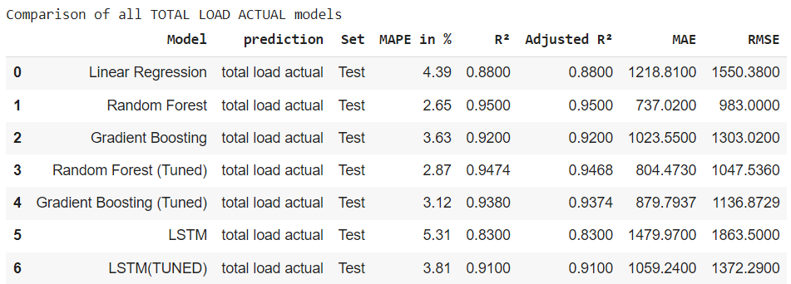
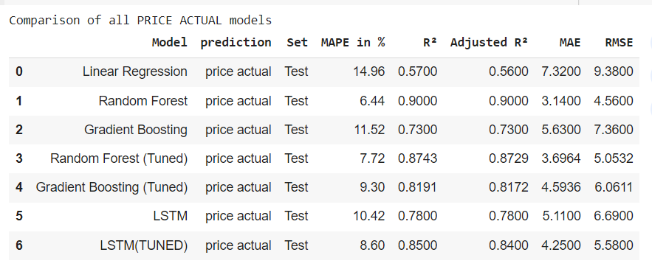
COMPARISON OF DIFFERENT ML MODELS
INFERENCES:
We are selecting RANDOM FOREST model for predicting variable ‘total load actual’
We are selecting RANDOM FOREST model for predicting variable ‘price actual’
For both the variables the RANDOM FOREST model has the lowest MAPE %, MAE and RMSE values and highest R Squared and adjusted R squared values.

Slide 18
LISTING IMPORTANT FEATURES
TOTAL LOAD ACTUAL
'max demand daily’
'generation hydro pumped storage consumption’
'generation hydro water reservoir’
'generation fossil gas'
PRICE ACTUAL
'total load forecast’
'total load actual’
'seasons_Spring '
'generation fossil gas'
Metrics for Total Load Actual using Random Forest:
MAPE: 4.39%
R2: 0.88
Adjusted R2: 0.88
MAE: 1218.81
RMSE: 1550.38
FINAL MODEL FOR TOTAL LOAD ACTUAL AND PRICE ACTUAL- RANDOM FOREST
Metrics for Price Actual
using Random Forest:
MAPE: 6.44%
R2: 0.90
Adjusted R2: 0.90
MAE: 3.14
RMSE: 4.56

Slide 19
CONCLUSION
Data sources:
Energy dataset
Weather Features dataset
Data cleaning techniques:
Missing value imputation using forward fill and backward fill
Data transformation/ normalization:
Original merged dataset encoded using one hot encoding technique
Data scaling done for hyperparameter tuned models to reduce computational time and increase accuracy
Model selection criteria
Evaluation metrics-mean absolute percentage error , mean absolute error, root mean squared error,
r squared and adjusted r squared values
Interpretability of the model
Scalability of model
Models designed to scale efficiently with increasing data volumes.
Capable of handling real-time data streams for continuous prediction and adjustment.
Potential to deploy models in various geographical regions with minimal adjustments.
~THANK YOU~

